Slide 1
A Project on Supply Chain Management
By Group-1
Presented by-:
Sayali Nawanit
Richa Jemadevi
Anjali Nema
Shubham Nema
Jenil Sejpal
Sanket Karane

Slide 2




Tools used

Slide 3
Introduction
By analyzing this data set ,we aim to understand performance of supply chain management ,identify trends and extract valuable insights to drive business growth and improve overall efficiency .
The project will involve exploring different aspects inventory management such as top store ,daily sales of products, sales by region, profit margin, inventory value ytd, qtd, mtd total customers performance and many more………
Through this supply chain management analysis project ,we hope to cover valuable insights that can be contribute to better decision making operational efficiency and customer satisfaction .
The finding and analysis could potentially guide marketing and inventory strategies ,sellers ,customers onboarding & other crucial aspects of the economic business.

Slide 4
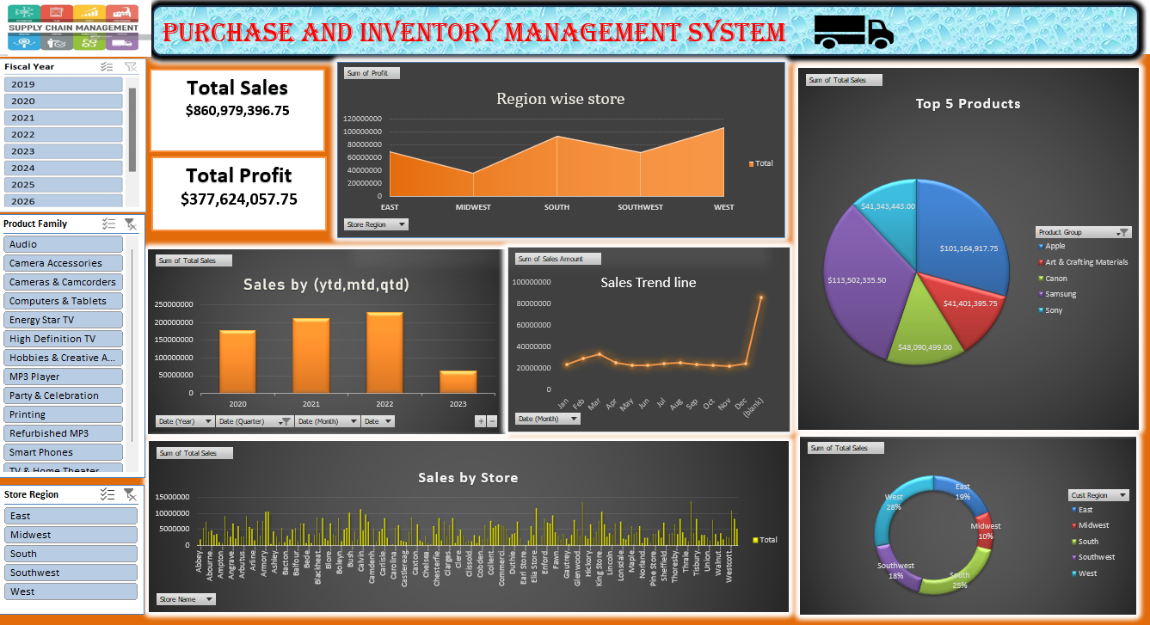
Module 1

Slide 5
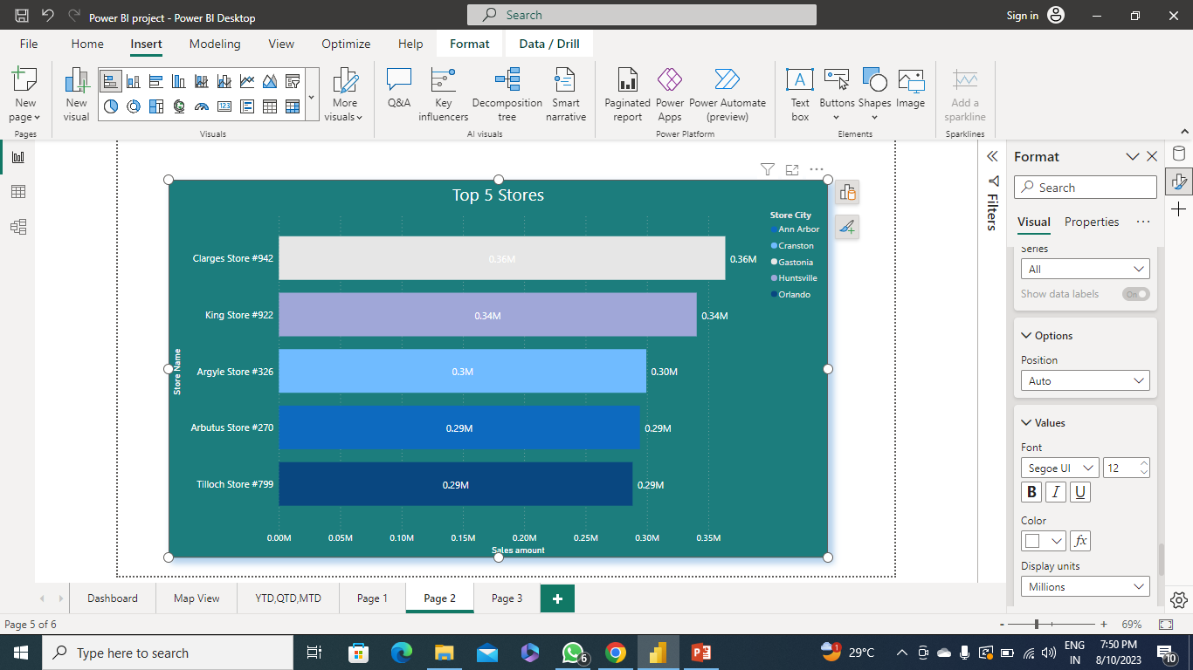

In this chart, as per maximum sales these are the top 5 stores out of 200 stores.
1.Clarges store in Gastonia city $0.36M
2.King store in Huntsville city $0.34M
3.Argyle store in Cranston city $0.3M
4.Arbutus store in Ann arbor city $0.29M
5.Tilloch store in Orlando city $0.29M

Slide 6

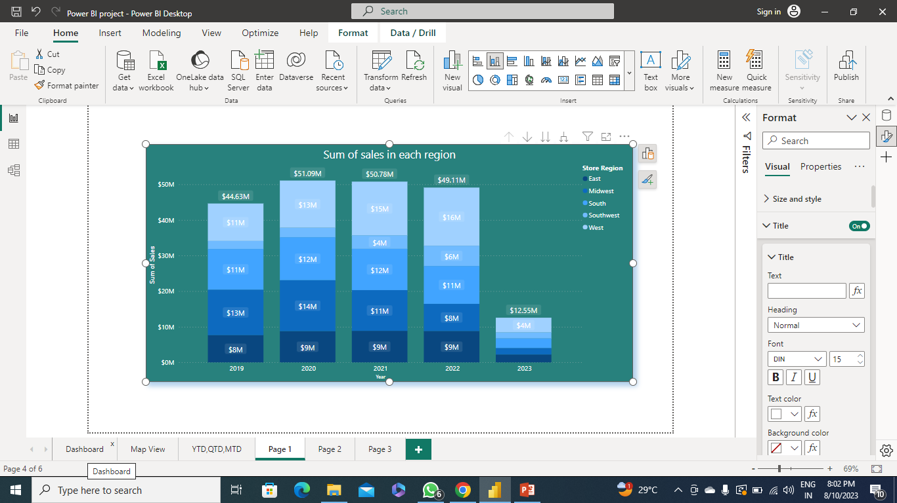
Year wise Sales in all regions
As we can see in the above mentioned visual , the highest sales in 2019 is $13M i.e. in Midwest region and the lowest sales in the same year is $8M. Likewise in 2020 the maximum sales goes up to $14M in the same Midwest region and the lowest sales was $9M. And in 2021 the lowest sales dropped to $4M in southwest and maximum sales increased by $15M in west region. In 2022,the lowest sales increased slightly by $6M in southwest and the highest sales was $16M which is the maximum sales among all the regions. In the current year 2023, till now the sales was very less as compared to the previous years which is $12.55M in total.

Slide 7
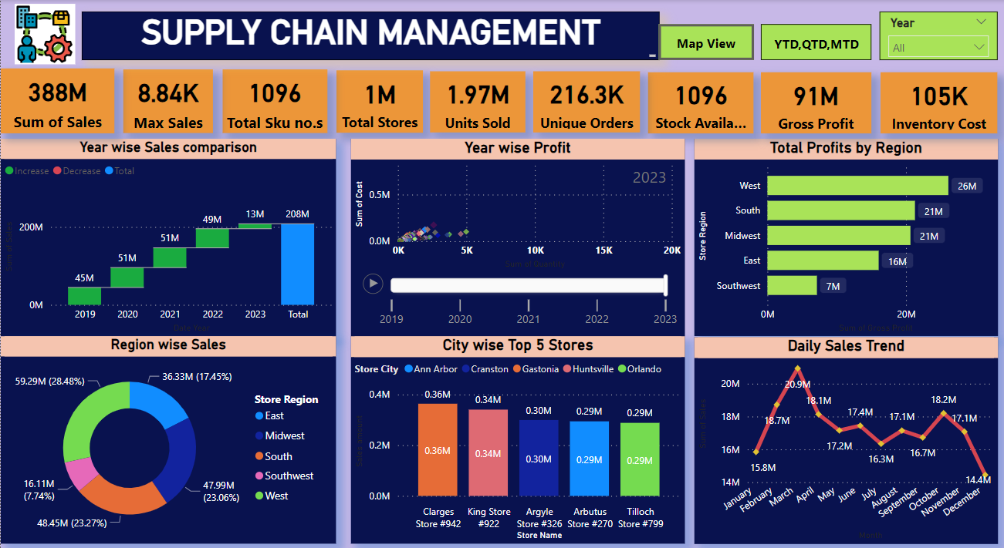
Module 2

Slide 8
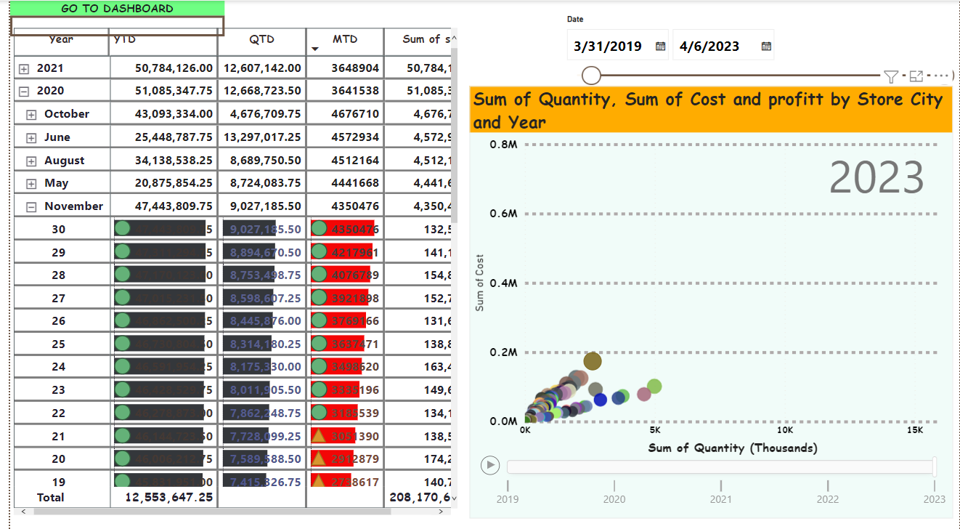
Ytd qtd mtd analysis and animated bubble chart
Power BI visualizations, "YTD," "QTD," and "MTD" are common time-related calculations that help users analyze data in the context of different time periods.
they allow you to assess how performance is developing over specific time frames and facilitate comparisons between different periods and sum of sales.
Creating a bubble chart in Power BI with a play axis that represents the sum of quantity, sum of cost, and profit involves visualizing these three metrics in a dynamic manner over time.

Slide 9
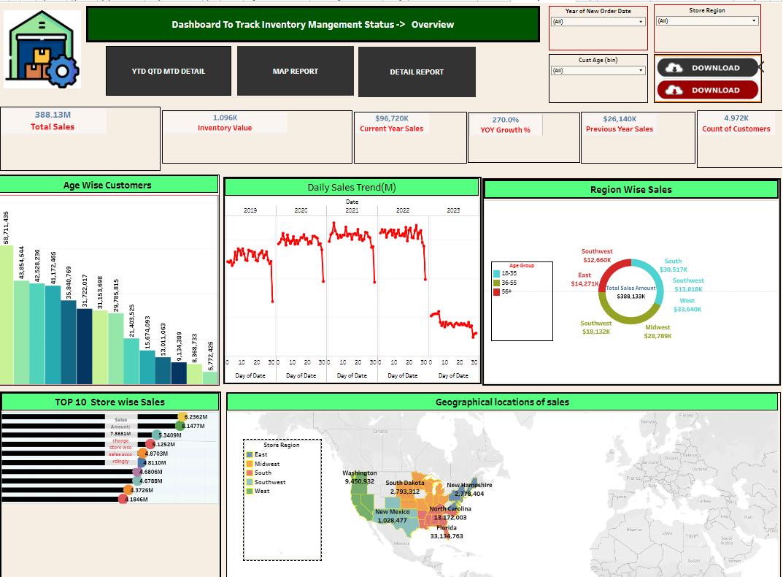
Module 3

Slide 10
MODULE-1 Key Performance Indicator's (KPI’s) have been incorporated into an Excel Dashboard to help us gain insightful knowledge about out company. Slicers and Filters have been used to create dynamic Visualizations. Now we have the ability to quickly explore trends and patterns across several dimensions by slicing and dicing our date. Our Dashboard quickly adapts as you dive down by date, region, product category, or any other significant feature, exposing deeper information. The maximum amount of Sales is in MARCH, so the company have to work hard all other month, and start some offer to increase the SALES.
Module-2 With the addition of actions & Filter’s, we have advanced our data analysis and create a Dashboard that is even more robust and engaging. You can drive down particular data points, study in depth information, or discover related insights with only a click or hover.
Model-3 With the help of single-card KPI’s , we are able to create a dashboard that offers a clear-cut overview of crucial information. Slicers' have created dynamic visualizations that make it simple for you to engage with the data, you can quickly filter and cut the data depending on a variety of parameters, Including data, area, product type or any other criterion pertinent to you study.

Slide 11
Summary
During this project on supply chain management Analysis We utilized Excel , for data modelling, manipulation and visualization.
We Employed dashboards in Tableau and Power bi to create a comprehensive view of key performance indicator(KPI’S).
The kpi’s we focused on daily sales trends , region wise sales , top n stores ,brand wise sales, Inventory value, profit margin , unique orders, total orders nd so on…
Overall regular monitoring of customer reviews ,real time tracking of fleet performance , together with proper shipment tracking and communication system can improve supply chain management delivery and performance and ensure are highly satisfied with the overall sales.

Slide 12
THANKYOU

